Slide 1

Thank you, TechBash 2025 Sponsors!
2025 Speaker sponsors: Redgate, Uno Platform, Geneca

Slide 2
Introduction to Accessibility

Slide 3
Disclaimer
Everything said here is my own opinions and not representative of my current or former employers.
While I will mention regulations, I am not able to provide legal representation/consultation.

Slide 4
Agenda
What is Accessibility?
Accessibility Guidelines
Accessibility Regulations
Why care?
What can you do?
Tools and Resources

Slide 5



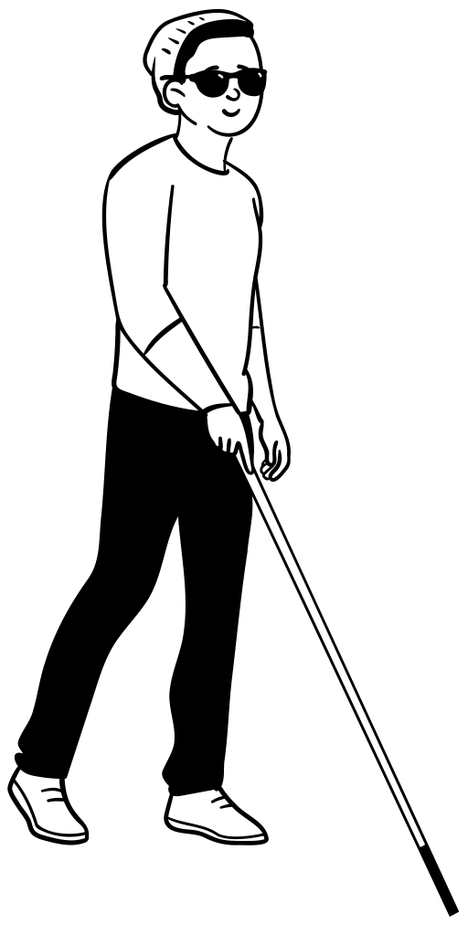
What is Accessibility?
A11y
  Numeronym
Accessibility
  Flexibility
Disability
  Medical vs Social
  Visibility
  Duration
  Area of Impact
Disabled
Permanent / Temporary / Intermittent
Assistive Technology
  Low tech v High Tech
Notes:
Accessibility – how well can your product be used by people of all abilities?
Disability – A disability is basically a mismatch in interaction between a person’s body and the features of their environment in which they live.
Accessible Technology (AT) - is any item, piece of equipment, software program, or product that is used to increase, maintain, or improve the functional capabilities of people with disabilities.
A11y – a commonly accepted numeronym for Accessibility that stands for the fact that Accessibility starts with an “A”, ends with a “Y” and has 11 characters in between.
Jeremy Andrew Davis has awesome videos describing the differences between the Social and Medical models on Instagram and LinkedIn:
JeremyAndrewDavis (@jeremyandrewdavis) • Instagram photos and videos
(8) Jeremy Andrew Davis | LinkedIn
(63) Cinema Therapy - YouTube

Slide 6





Accessibility Guidelines
WCAG | ATAG | UAAG | ARIA | PDF/UA

Slide 7


Accessibility Regulations
Section 508 | ADA

Slide 8



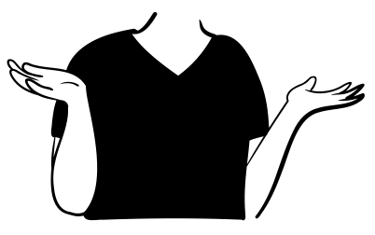
Why care?
  Helps everyone
  Create welcoming environment
  Better public image
  Increased retention
  Increased productivity
  Be more innovative
  Reach more customers
  Why should I care?

Slide 9
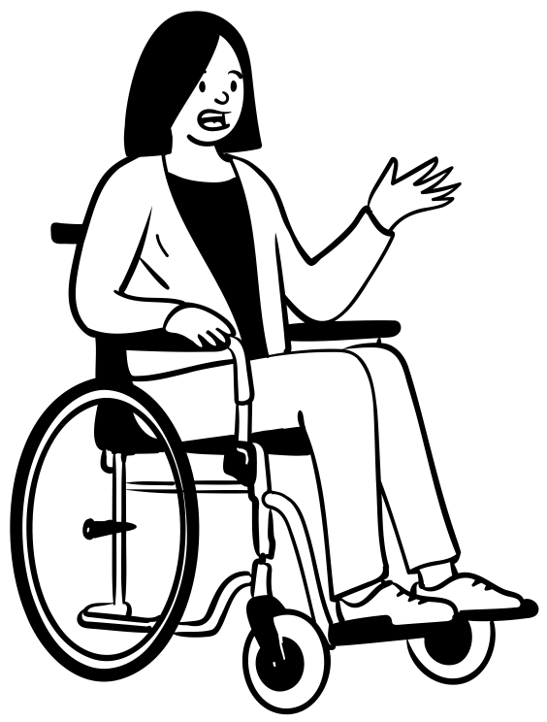
What can you do?
Shift-left
Listen
Speak up
Respectful, people first language
Follow coding best practices
Use semantic web elements
Don’t use an Accessibility Overlay
  Learn more at: https://overlayfactsheet.com/

Slide 10
Tools and Resources
Accessibility Insights – A Accessibility testing tool made by Microsoft
  Has browser extension and desktop application versions
  Also have the option to include the automated tests in CI/CD
  DON’T depend on automated tests
NVDA – free, open-sourced screen reader
  View keyboard shortcuts on at the Deque article entitled: NVDA Keyboard Shortcuts.
Narrator – screen reader built into Windows.
  View keyboard shortcuts for Narrator in the Deque article entitled Narrator Keyboard Shortcuts.
Microsoft Accessibility on Twitter at @MSFTEnable and at on the Microsoft Accessibility page.
Microsoft Accessibility Fundamentals course
ANDI – Bookmarklet developed by the Social Security Administration to aid in accessibility testing.
VGAR – Visa Global Accessibility Requirements
Section 508 ICT Testing Baseline for Web - This Baseline identifies the minimum requirements of any test process used to determine conformance of web content with the Revised Section 508 of the Rehabilitation Act of 1973, as amended (29 U.S.C. 794d).
Trusted Tester: Section 508 Conformance Test Process for Web – A standardized approach for manual inspection of web content for conformance with the revised Section 508 Standards.
IT Accessibility Laws and Policies | Policy & Management | Section508.gov – A page maintained by the GSA that provides information on some Accessibility related laws and policies
Web Accessibility Laws & Policies | WAI | W3C – Lists some United States governmental policies, regulations, and standards related to web accessibility.

Slide 11

Thank You & QA
https://linktr.ee/corgidev

